Slide 1
14009 - Convolutional Neural Network

Slide 2
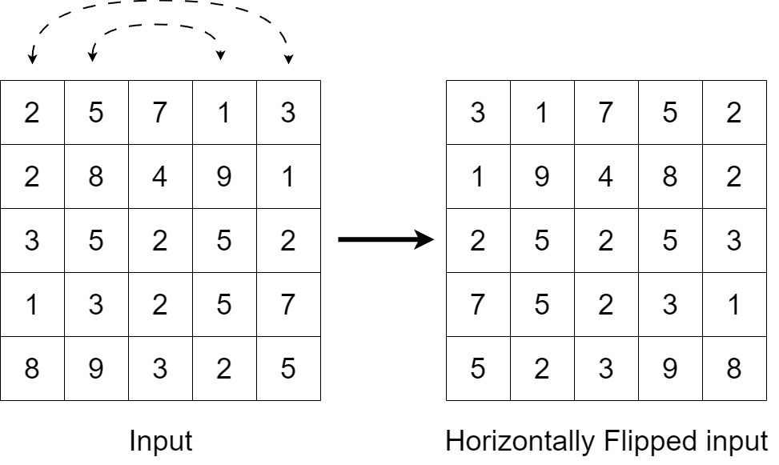
Problem Description
Today, Stiff Waist Beast wants to implement a small CNN, which processes an input image that is represented as a matrix of pixels with the following steps:
Horizontally flip the input image to enable the CNN to handle images with varying orientation.
Apply convolution using a filter to the flipped image.

Slide 3
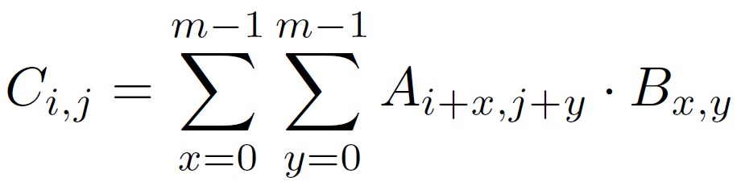
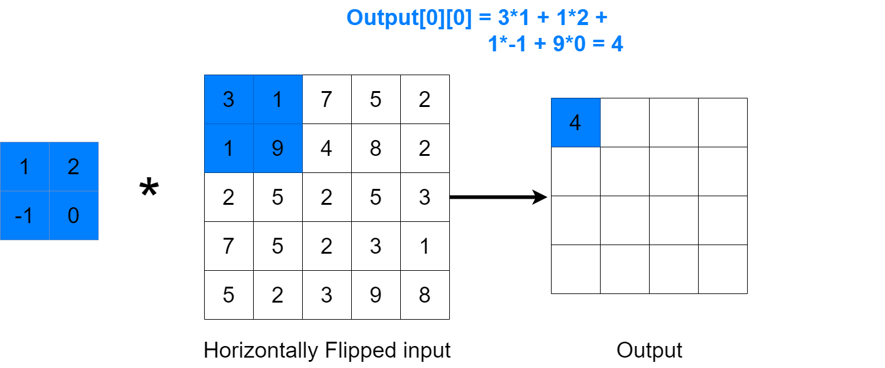
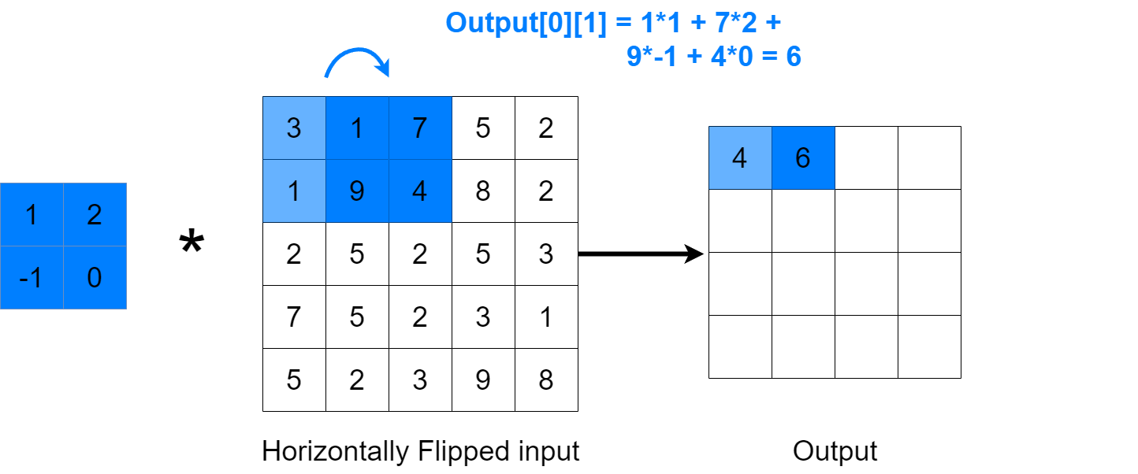
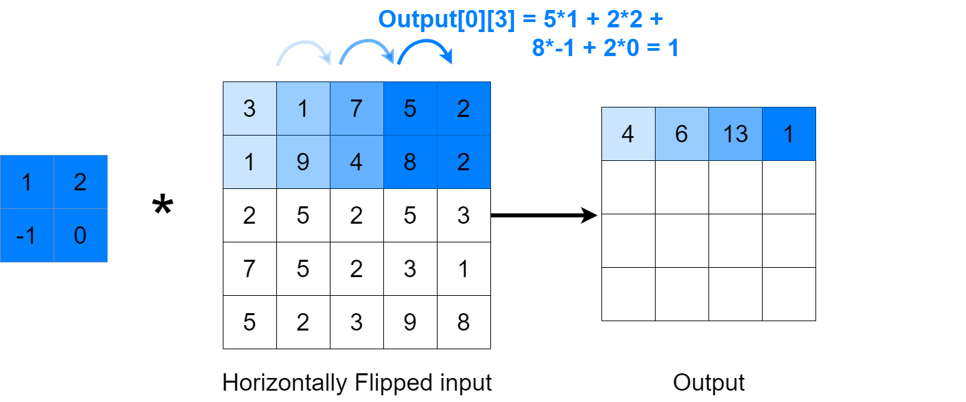
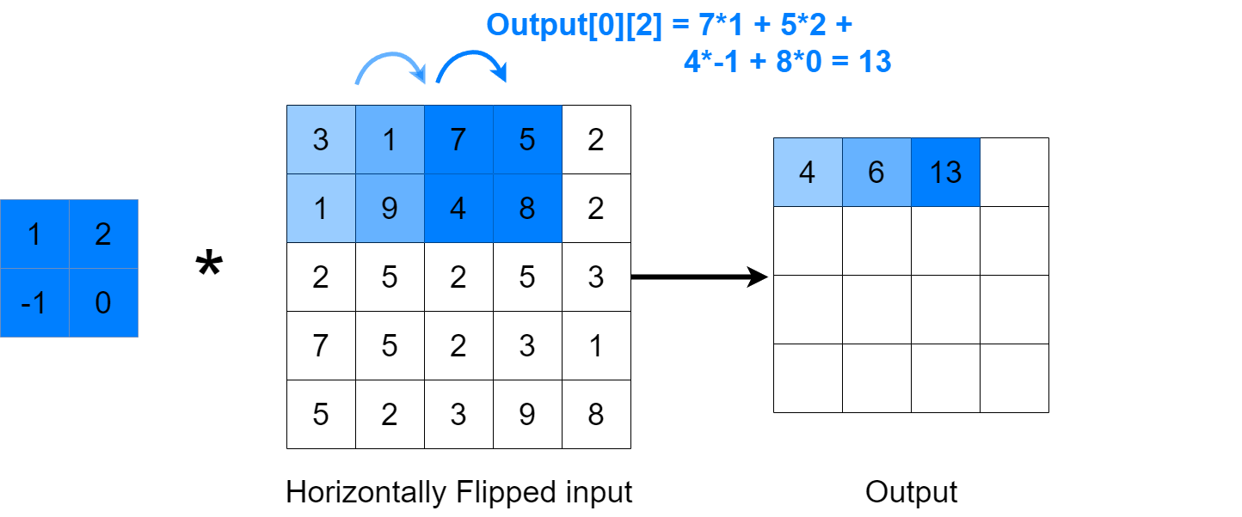
Problem Description
The convolution is defined as follows:
Given an n * n image A and an m * m filter B, the resulting feature map after convolution is another (n - m + 1) * (n - m + 1) matrix C, where each element of C is computed as

Slide 4
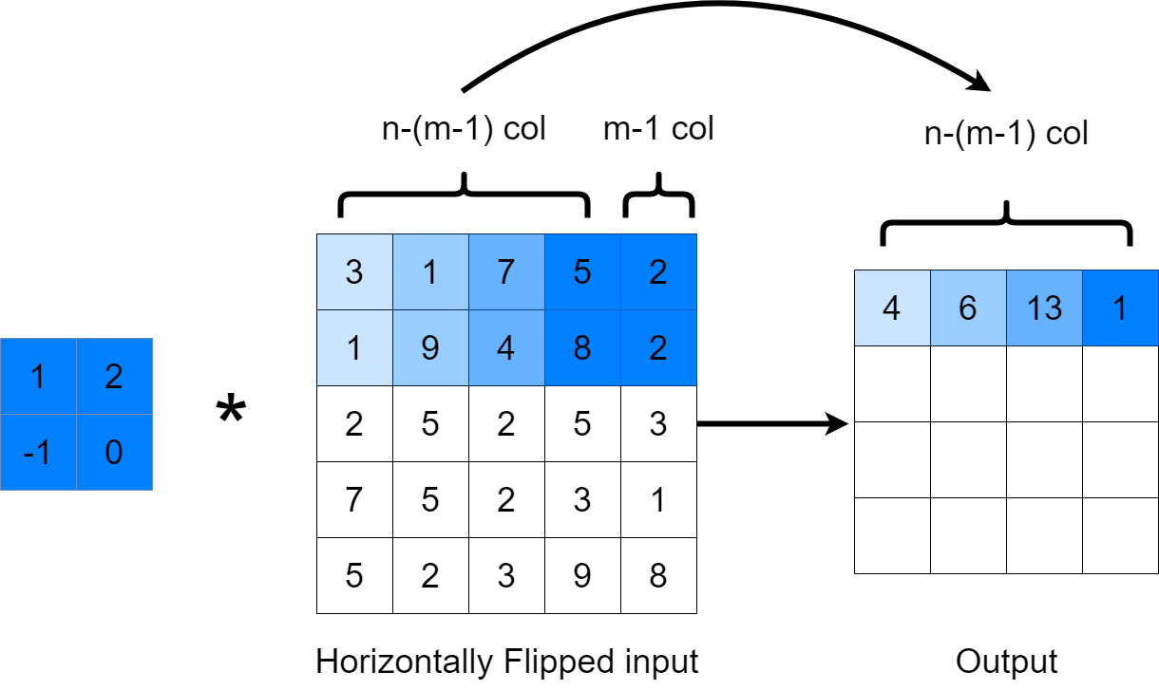
Problem Description
The convolution is defined as follows:
Given an n * n image A and an m * m filter B, the resulting feature map after convolution is another (n - m + 1) * (n - m + 1) matrix C, where each element of C is computed as

Slide 5
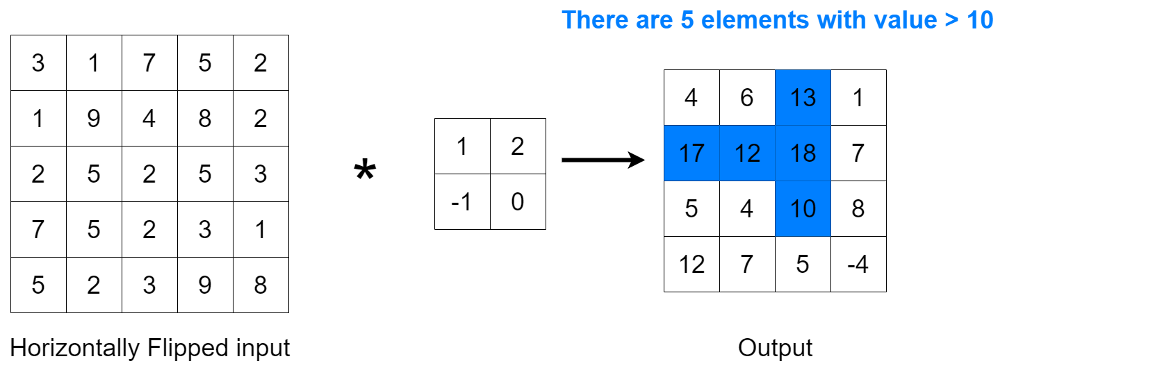
Problem Description
Finally, Stiff Waist Beast is curious about the number of pixels in the resulting feature map whose values exceed a given threshold k (for fun only ^^).
As a poor student, there are still many tasks waiting for Stiff Waist Beast to handle in the association. He asks you to finish this task.

Slide 6
Input
The first line contains an integer T, representing that there will be T testcases.
The first line of each testcase has three integers n, m, k.
Each of the following n lines has n integers, a_{ij}, representing image A.
Each of the following m lines has m integers, b_{ij}, representing filter B.

Slide 7
Input Range
1 <= T <= 10, 1 <= n <= 500, 1 <= m <= min(n, 5)
0 <= a_{ij}, k < 256, -5 <= b_{ij} <= 5.

Slide 8
Output
Print an integer: the number of elements in the resulting feature map C whose values exceed the given threshold k.
Don't forget to print '\n' in the end!

Slide 9
Sample Test Case
Input: 1 5 2 10 2 5 7 1 3 2 8 4 9 1 3 5 2 5 2 1 3 2 5 7 8 9 3 2 5 1 2 -1 0
Output: 5

Slide 10
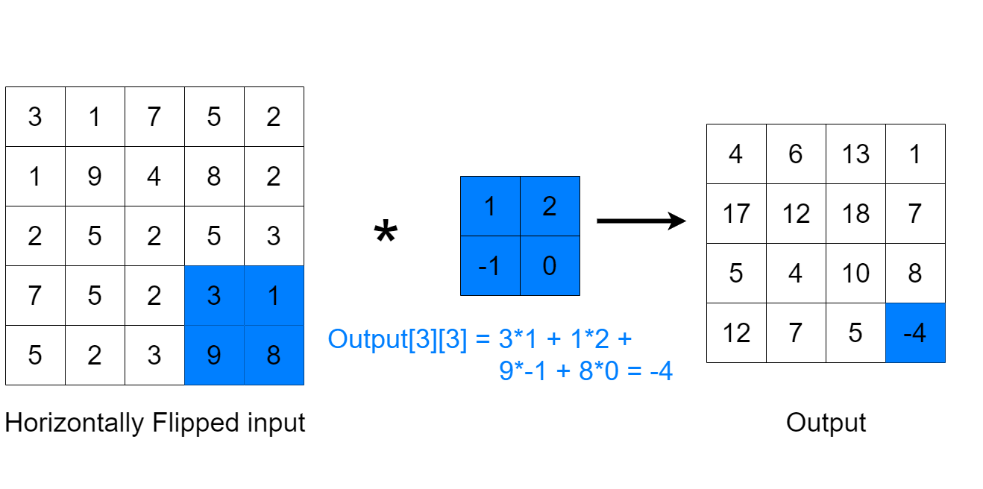
Sample Test Case

Slide 11
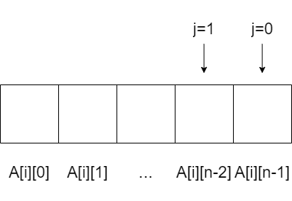
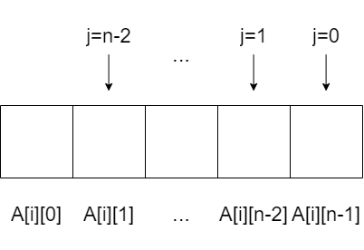
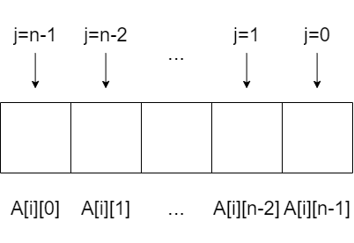
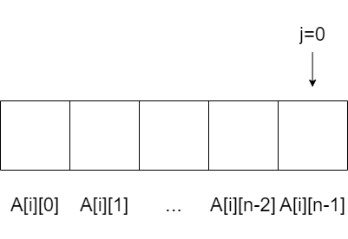
Read Inputs & Horizontally Flip
int T, n, m, k, ans;
int A[505][505], B[5][5];
scanf("%d", &T);
while(T--){
scanf("%d%d%d", &n, &m, &k);
for(int i=0; i<n; i++)
for(int j=0; j<n; j++)
scanf("%d", &A[i][???]);
for(int i=0; i<m; i++)
for(int j=0; j<m; j++)
scanf("%d", &B[i][j]);
ans = 0;
Perform a horizontal flip by writing from right to left.

Slide 12
Read Inputs & Horizontally Flip
int T, n, m, k, ans;
int A[505][505], B[5][5];
scanf("%d", &T);
while(T--){
scanf("%d%d%d", &n, &m, &k);
for(int i=0; i<n; i++)
for(int j=0; j<n; j++)
scanf("%d", &A[i][n-j-1]);
for(int i=0; i<m; i++)
for(int j=0; j<m; j++)
scanf("%d", &B[i][j]);
ans = 0;
Perform a horizontal flip by writing from right to left.

Slide 13
Convolve & Output
while(T--){
...
for(int i=0; i<???; i++){
for(int j=0; j<???; j++){
}
}
}

Slide 14
Convolve & Output
while(T--){
...
for(int i=0; i<n-m+1; i++){
for(int j=0; j<n-m+1; j++){
int sum = 0;
for(int x=0; x<m; x++)
for(int y=0; y<m; y++)
sum += A[i+x][j+y] * B[x][y];
}
}
}
while(T--){
...
for(int i=0; i<n-m+1; i++){
for(int j=0; j<n-m+1; j++){
}
}
}
Loop through the m*m filter to do the convolution

Slide 15
Convolve & Output
while(T--){
...
for(int i=0; i<n-m+1; i++){
for(int j=0; j<n-m+1; j++){
int sum = 0;
for(int x=0; x<m; x++)
for(int y=0; y<m; y++)
sum += A[i+x][j+y] * B[x][y];
if(sum > k) ans++;
}
}
printf("%d\n", ans);
}
Loop through the m*m filter to do the convolution
Check whether the result is greater than k

